Slide 3
Transparent film
Disadvantages | Advantages | Indications
Non absorptive May adhere to some wounds Fluid retention may lead to maceration of peri wound area | Wound inspection Impermeable to fluids and bacteria Conformable Promotes autolytic debridement Prevents or reduces friction Numerous size | Partial thickness wounds Stage 1,2 PU Superficial burns Donor sites

Slide 4
Hydrocolloid
Disadvantages | Advantages | Indications
Some are opaque Not recommended for heavily draining wounds ,sinus. Some may difficult to remove and may leave a residue Odor can be confused with infection | Autolytic debridement Conformable Reduction of pain Thermal insulation Minimal to moderate absorption Long wear time (up to 7 days); decrease frequency of dressing change Numerous sizes,forms | Partial and full thickness wounds PU Dermal ulcers Granular wounds Necrotic wounds Preventive dressing

Slide 5
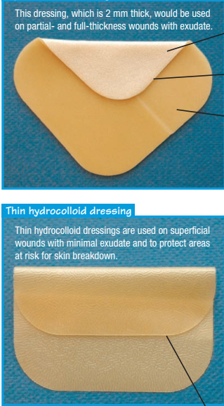

Slide 6
Hydrogel
Disadvantages | Advantages | Indications
Some require secondary dressing to secure May macerate periwound skin Not recommended for heavily draining wounds Daily dressing change may be need | nonadherent trauma free removal Rehydrates the wound bed Minimal to moderate absorption Can be used with topical medications, in infected wounds and in cavities or tunnels Softens and loosens necrosis and slough Numerous sizes and forms | Stage 2-4 PU Partial and full thickness wounds Dermal abrasion Painful wounds Skin tears Minor burns Radiation burns Donor sites Necrotic wounds

Slide 7
Foam
Disadvantages | Advantages | Indications
Not recommended for nondraining wounds Not recommended for dry eschar Not all forms recommended for infected wounds and tunnels May require secondary dressing or tape May macerate periwound area if not change appropriately | nonadherent Trauma free removal Conformable Fluid management Easy to apply and remove frequency of dressing change may be different up to 7 days Numerous sizes and forms | Partial and full thickness wounds with minimal or heavy drainage Stage 2-4 PU Surgical wounds Dermal ulcers Under compression wraps or stocking Infected and noninfected wounds Tunneling and cavity wounds

Slide 8
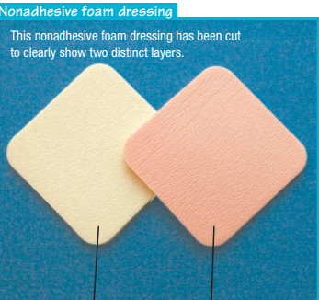

Slide 9
Calcium alginate
Disadvantages | Advantages | Indications
Contraindicated for dry eschar,third degree burns,surgical implantation and heavy bleeding May require secondary dressing Gel may have odor during dressing change Can desiccate the wound bed if not change appropriately Some forms can leave fibers in the wound bed if drainage not sufficient to gel product | Highly absorbent and nonocclussive Trauma free removal Can be used on infected and tunneling wounds Hemostatic properties for minor bleeding Reduced frequency of dressing change Facilitates autolysis Available in different forms | Partial and full thickness wounds Moderate to heavy draining wounds Stage 3-4 PU Surgical incision/dehisced wounds Post operative wounds for hemostasis Sinus tracts, tunnels, or cavities Infected wound Donor sites

Slide 10
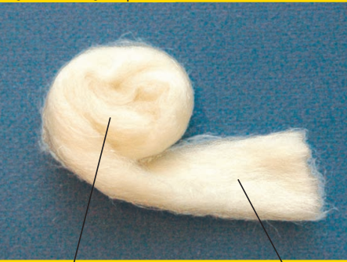

Slide 11
collagens
Disadvantages | Advantages | Indications
Contraindicated for dry wounds,3 degree burns Not recommended for necrotic wounds Require secondary dressing to secure May require rehydration | absorbent and nonadherent Conforms well, easy to apply Change in 1-7 days ;daily if infected May be used with topical agents and other dressings Available in numerous size and forms | Partial and full thickness wounds Stage 3 and some stage 4 PU Infected wounds Tunneling wounds Dermal ulcers Donor sites Skin grafts Surgical wounds

Slide 12
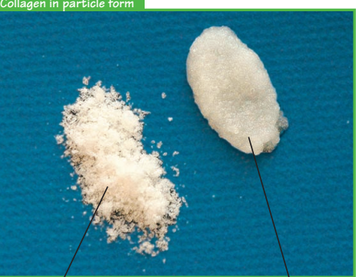

Slide 13
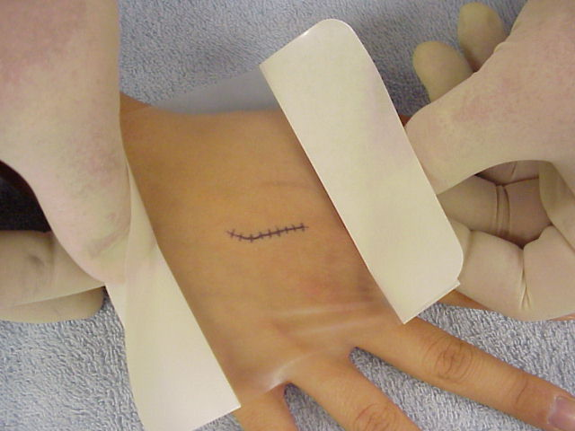

Slide 14
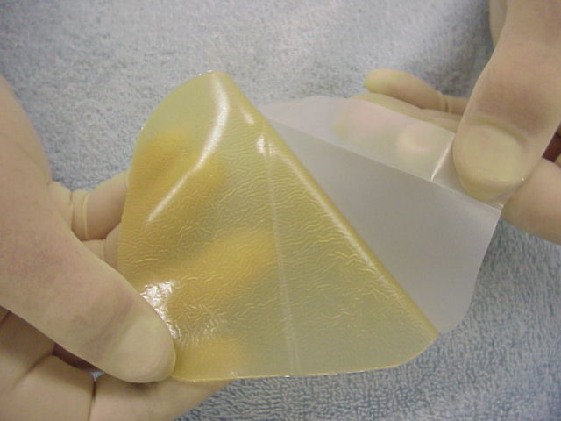

Slide 15
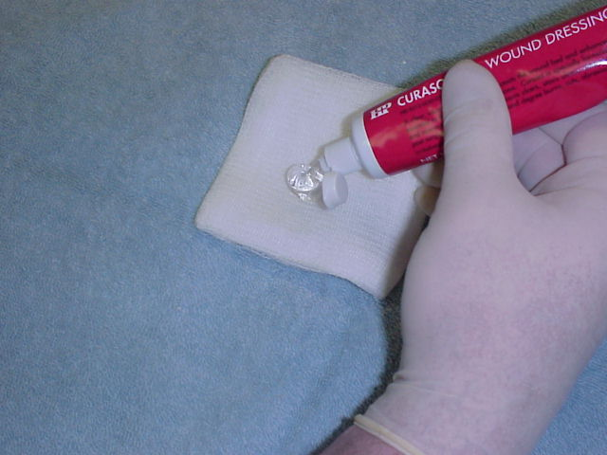

Slide 17
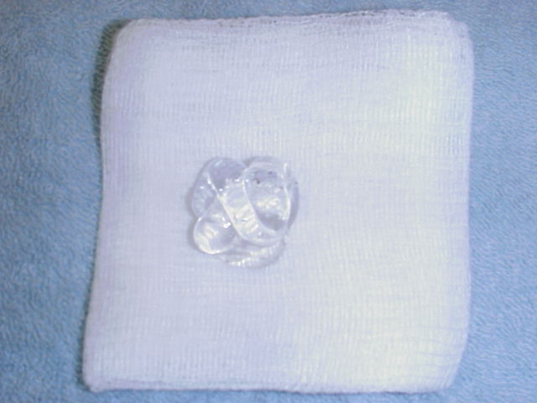

Slide 18
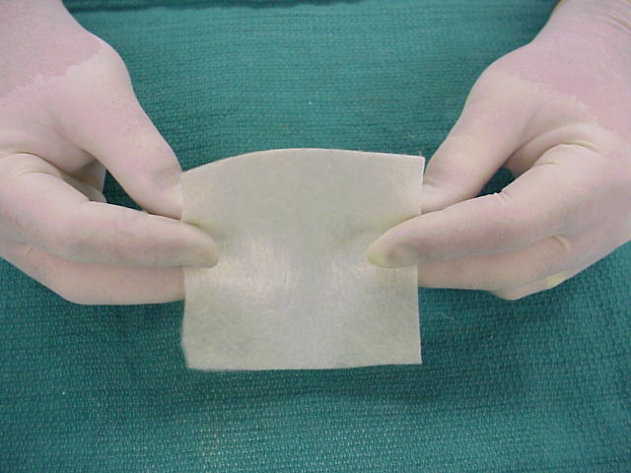

Slide 20
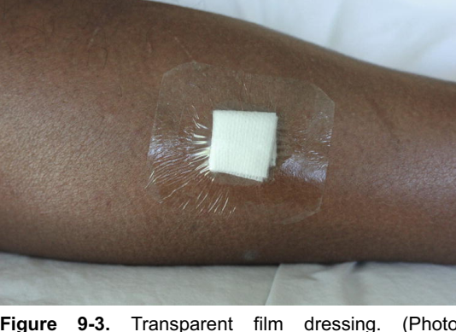

Slide 21
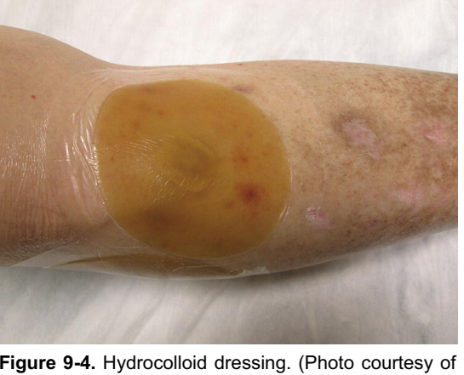

Slide 22
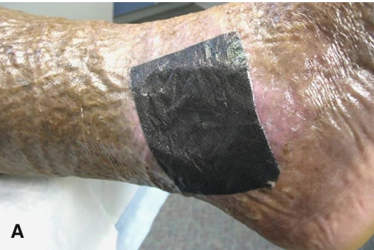

Slide 23
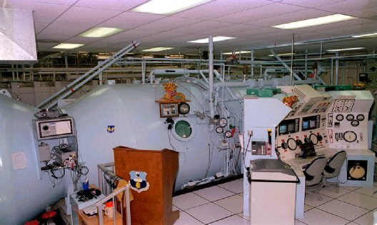

Slide 24
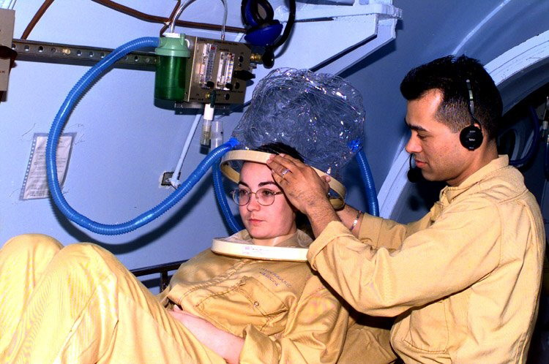

Slide 25
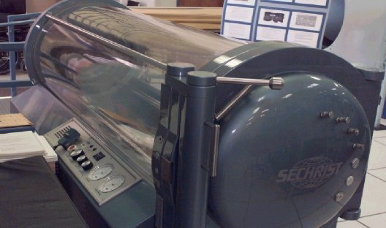

Slide 26
Maggot therapy

Slide 27
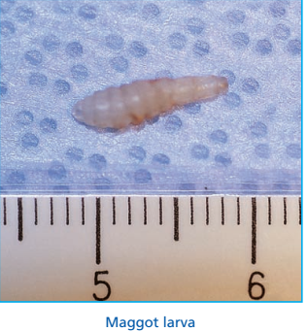
Maggot therapy is a type of biological therapy in which live, sterilized, medicinal Lucilia sericata (green bottle fly) maggots are placed in a wound every 2 to 3 days, either directly or in a saclike device.

Slide 28
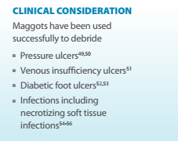
The maggots secrete a proteinase enzyme that helps degrade necrotic tissue and digest bacteria, which promotes healing in wounds with resistant microorganism strains.
Maggots selectively debride by feeding on the necrotic tissue, cellular debris, and exudate in wounds.

Slide 29
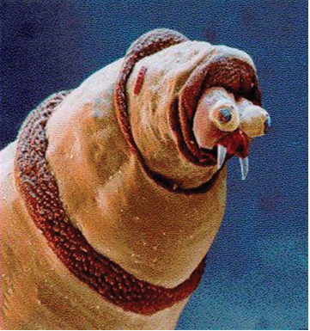
The maggots also stimulate formation of granulation tissue. Although cost-effective, this treatment can be painful.

Slide 30
Marked antimicrobial activity has been detected against Streptococcus A and B and Staphylococcus aureus, with some activity detected against Pseudomonas sp and a clinical isolate of a resistant strain of S aureus (MRSA) .

Slide 31
Growth of granulation tissue has been reported to be faster with better wound healing rates using maggot therapy.
One study suggests that a possible mode of action for facilitating wound healing is the increase in tissue oxygenation that takes place when using maggot therapy.

Slide 32
Early scientific reports of the evidence support that free-range maggot therapy maximizes debridement benefits compared with maggots that are contained in pouches or sacks and then placed in the wound.

Slide 33
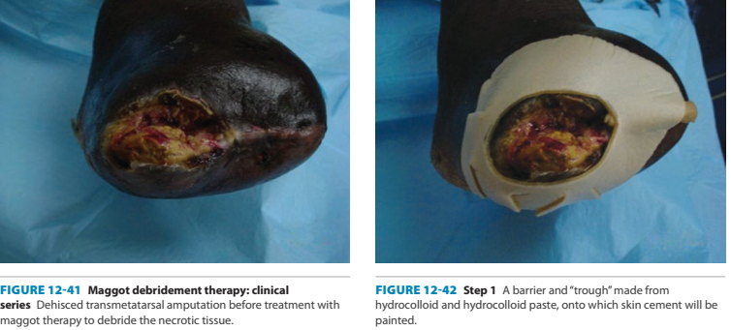

Slide 34
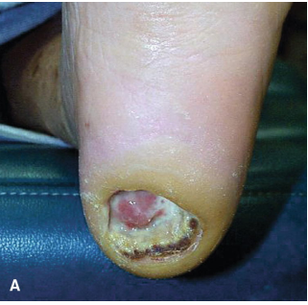
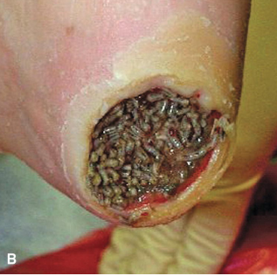
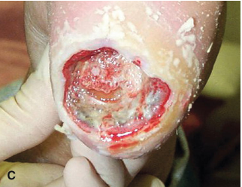

Slide 35
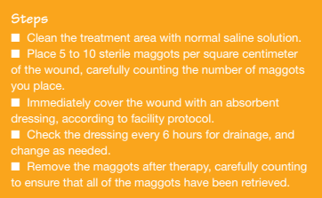

Slide 36
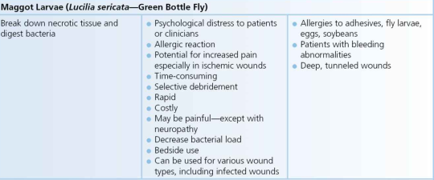

Slide 37
Off-loading

Slide 38
Patients with diabetic neuropathy no longer feel the pain that normally precedes tissue damage. Therefore, relieving pressure from plantar tissues—known as off-loading—is key to treating and preventing ulcers. Off-loading can be accomplished using nonsurgical and surgical interventions.

Slide 39
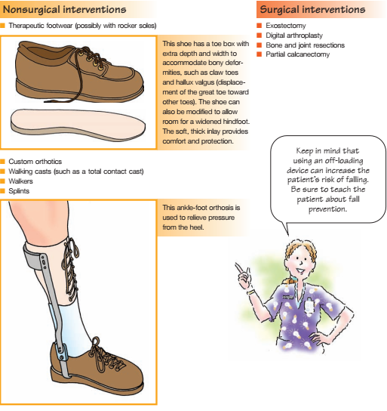

Slide 40
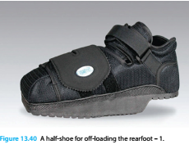

Slide 41
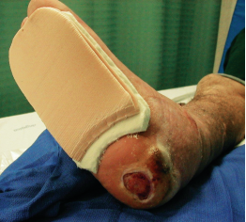
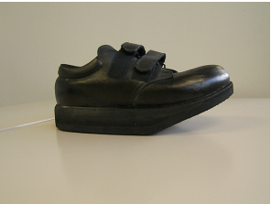

Slide 42
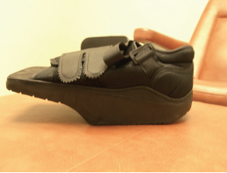
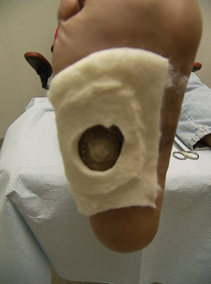

Slide 43
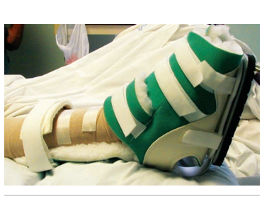

Slide 44
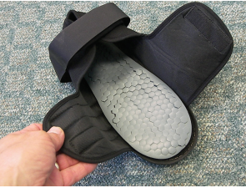
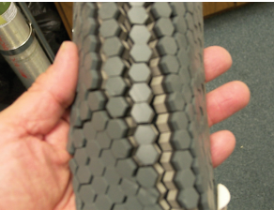

Slide 45
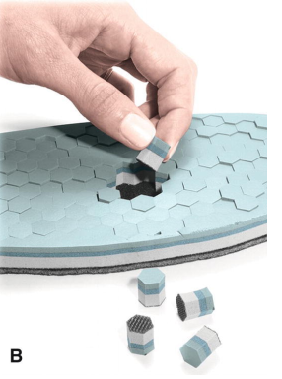
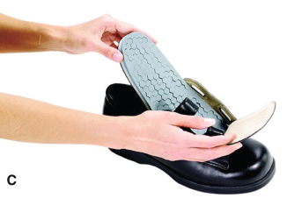

Slide 46
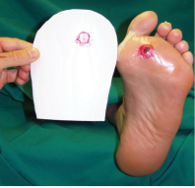
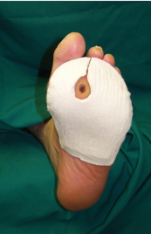

Slide 47
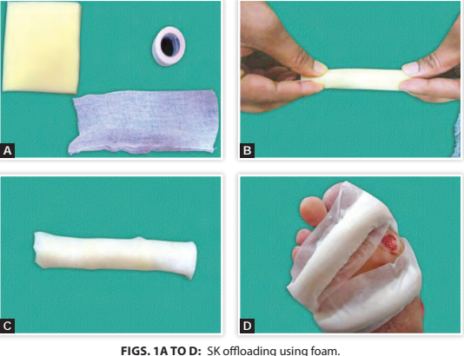

Slide 48
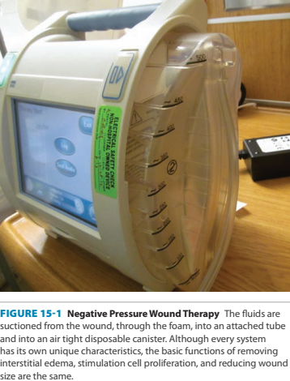
Negative pressure wound therapy

Slide 49
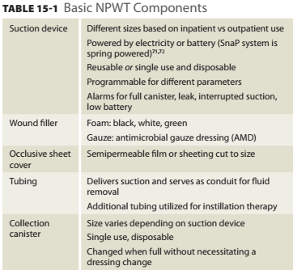

Slide 50
When a wound fails to heal in a timely manner, negative pressure wound therapy may be used. Vacuum-assisted closure (VAC), an example of this type of therapy system, requires a special dressing, a vacuum tube, and a vacuum pump.

Slide 51
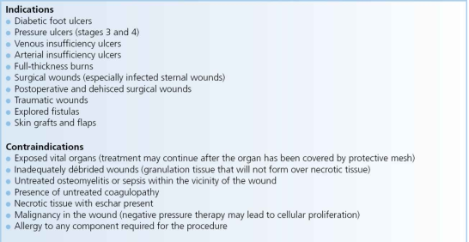

Slide 52
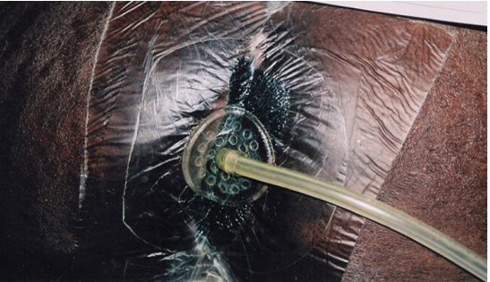

Slide 53
Promotion of moist wound healing
Reduction of edema and interstitial fluid
Increased local perfusion
Approximation of wound edges
Stimulation of granulation tissue formation
Reduction in bacterial load
Reduction in the frequency of dressing changes

Slide 54
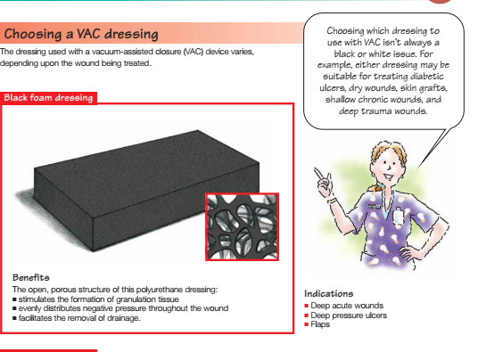

Slide 55
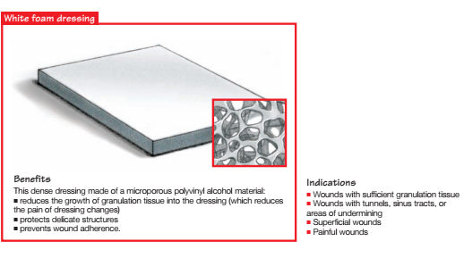

Slide 56
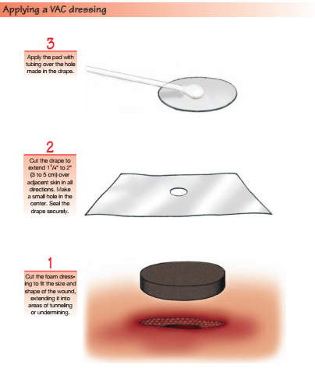

Slide 59
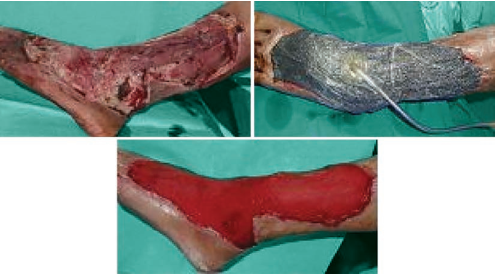

Slide 60
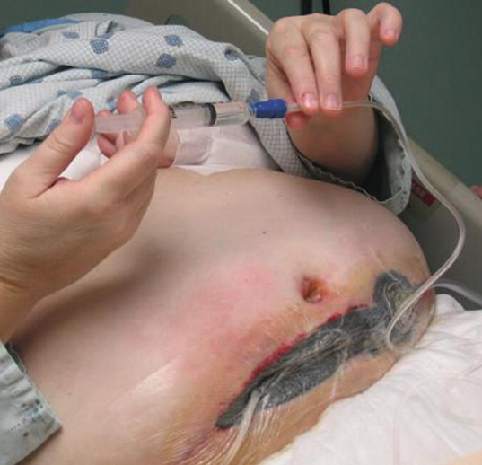

Slide 61
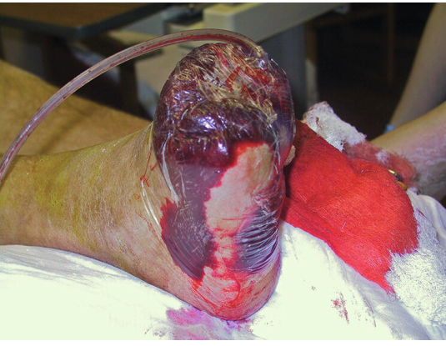

Slide 63
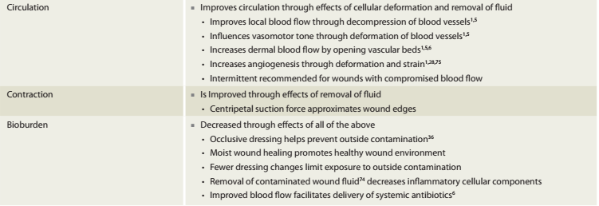

Slide 64
Compression Therapy

Slide 65
Four-layer compression bandages are used in the treatment/management of venous legs ulcers.
As the name suggests, there are four-layers of bandage. First a layer of gauze is applied which is nonadherent primary dressing which comes in contact with the wound. It allows the passing of exudates into the outer absorbent layer

Slide 66
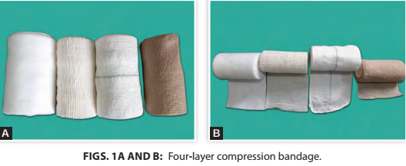

Slide 67
The first layer consists of absorbent wool which pads and protects bony prominences. It also absorbs exudates and perspiration and also evenly distributes pressure around limbs. Te second layer is a cotton crepe bandage. It compresses and ﬂattens orthopaedic wool to distribute compression eﬀectively

Slide 68
. Te third layer is an elastic compression bandage and acts as the frst layer of elastic compression sub-bandage.
Te fourth layer is cohesive compression bandage and the second layer of compression.

Slide 69
Te four-layer bandage delivers approximately 40 mm Hg pressure at the ankle, reducing to 17 mm Hg at the knee.
It delivers higher compression at the ankle, with reducing compression at the calf muscle. Te level of compression is maintained up to 7 days of application.

Slide 70
Te four-layer bandage is contraindicated in patients having Anklebrachial index (ABI) of <0.8 and patients with decompensated heart failure. It is very important that before applying four-layer compression bandage, venous color Doppler is mandatory to rule out deep vein thrombosis (DVT)

Slide 72
Nursing Precaution
Use compression therapy only if palpable pulses (dorsalis pedis and post tibial) are readily detected. If not, refer the patient to the attending physician for vascular studies.
This must be no less than 0.8 for compression therapy; also known as ankle-brachial indexes (ABIs).

Slide 80
Prevention of Medical Adhesive Related Skin
Injury (MARSI)*
1. Secure dressings with roll gauze, tubular stockinette, or self-adhering tape
(avoids unnecessary tape on skin).
2. Apply tape without tension (prevents blistering of skin under tape).
3. Use porous tapes (allows moisture to evaporate).

Slide 81
Use skin sealants, thin hydrocolloids, or solid-wafer skin barriers under adhesives (provides protective layer over skin for adhering tapes). 5. Secure dressings with Montgomery straps (prevents repeated tape applications). 6. Remove tape slowly, peel away from anchored skin, or pull one corner of tape at an angle parallel with skin. Solvents can be used to break bond with skin, although solvents have drying effect on skin. Plain tap water can often serve this purpose effectively (decreases trauma to epidermis and dermal–epidermal

